Slide 1

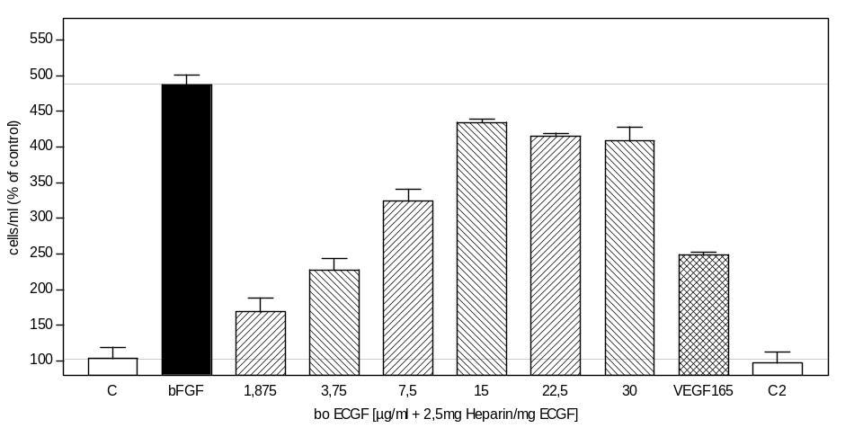
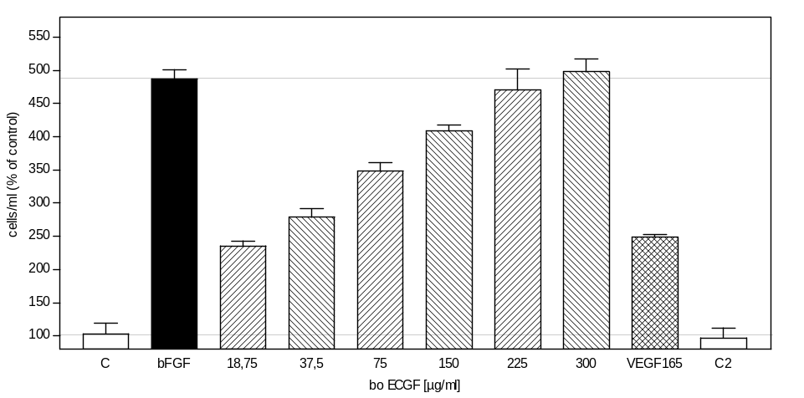
ReliaTech GmbH
ECGF-induced proliferation of HUVECs
(Cat #300-090/-090-H)
http://www.reliatech.de / orders@reliatech.de

